Slide 1

Promoting Healthy Eating in Egypt: A Digital Marketing Strategy
This presentation outlines a comprehensive digital marketing strategy for promoting healthy eating in Egypt, leveraging government initiatives, addressing rising health concerns, and harnessing the power of digital tools.

Slide 2
Why Promote Healthy Eating in Egypt?
Government Support
Rising Health Concerns
Egypt has launched several initiatives aimed at improving public health, such as the “100 million Healthy Lives” Initiative, the “Decent Life” Initiative, and the School Nutrition Initiative. These initiatives create an ideal environment for promoting healthy eating, as they align with national priorities, making it easier to gain government support and collaborate with health organizations.
Egypt is witnessing an increase in obesity, diabetes, and heart diseases due to the heavy reliance on unhealthy food. Lack of awareness about the importance of a balanced diet creates a need for awareness campaigns targeting different age groups.

Slide 3

Leveraging Digital Marketing
1
Social Media Engagement
2
Influencer Marketing
Digital marketing can be leveraged to promote healthy diets through social media, mobile applications, and websites. Engaging content can include easy and nutritious recipes tailored to Egyptian cuisine, challenges and interactive campaigns encouraging people to adopt a healthy lifestyle.
The rise of social media influencers promoting healthy lifestyles has increased public awareness of nutrition and its impact on health and beauty. Partnering with relevant influencers can amplify the campaign's reach and credibility.
3
Community Engagement
Organizing workshops on healthy nutrition in schools, universities, and workplaces can foster a sense of community and encourage active participation in the campaign.

Slide 4

Campaign Objectives
Raise Awareness
Encourage Gradual Change
Spread information about the benefits of proper nutrition for both body and mind. Highlight the risks of unhealthy food on overall health. Promote nutritional education through social media campaigns, advertisements, and community events.
Motivate people to replace unhealthy foods with nutritious alternatives. Provide practical tips for preparing easy and affordable healthy meals. Support the concept of "balanced nutrition" instead of extreme dieting.
Increase Engagement
Launch challenges such as "30 Days of Healthy Eating" and reward participants. Collaborate with influencers and nutrition experts to spread awareness in creative ways.

Slide 5
SWOT Analysis
Strengths
Weaknesses
Opportunities
Threats
Government Support & Initiatives
Slow Behavioral Change
Rise in Fitness & Health Trends
High Costs of Healthy Food
High Competition
Growing Awareness of Healthy Eating
Operational Costs
Expanding Partnerships
Cultural Resistance to Diet Change
Lack of Nutrition Education
Technology Integration
Effective Digital Marketing Strategies
Government & NGO Support
Fast-Food Industry Competition
Over-Reliance on Digital Marketing
Diverse Marketing Channels
Targeting Younger Generations
Economic Challenges
Short-Term Interest
Potential Partnerships

Slide 6
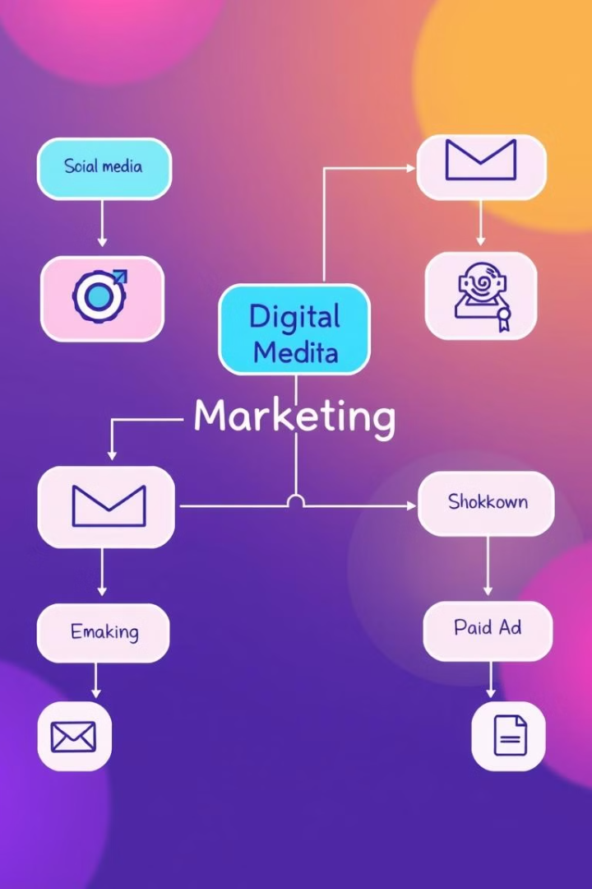




Digital Marketing Strategy
Social Media Marketing
Search Engine Optimization (SEO)
Email Marketing
Utilize Facebook, Instagram, YouTube to engage with the audience. Share engaging content such as healthy recipes, nutrition tips, and success stories.
Send weekly newsletters with recipes, health tips, and meal plans. Provide personalized content tailored to subscribers' health needs. Use reminders and notifications to keep the audience engaged.
Target keywords like “healthy meals,” “balanced diet,” “diet recipes.” Optimize website content for organic search rankings.
Paid Advertising (PPC)
Run Facebook and Instagram ads targeting health-conscious individuals. Utilize retargeting strategies to reach users who have shown interest in healthy eating.

Slide 7
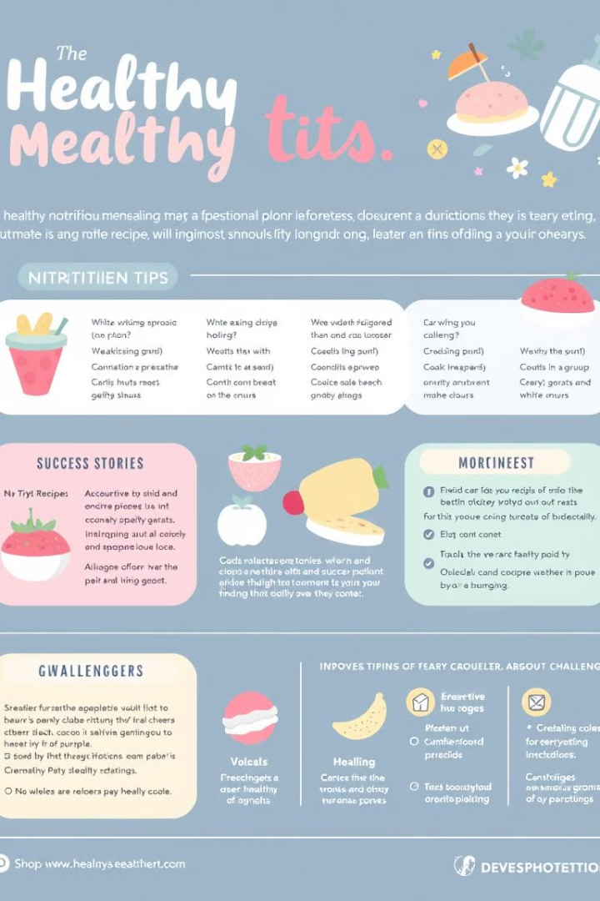
Content Marketing Plan
1
Educational Content
Articles and blogs about healthy eating benefits, nutrition guides, and food facts.
2
Visual Content
Short recipe videos, meal prep tutorials, and visually appealing infographics.
3
Challenges & Engagement
Interactive campaigns like "30 Days of Healthy Eating Challenge" to encourage participation and track progress.
4
Success Stories
Interviews with individuals who transformed their health through better nutrition, showcasing real-life results.

Slide 8
Key Takeaways & Next Steps
Promoting healthy eating in Egypt requires a multi-faceted approach that leverages digital marketing tools, addresses cultural nuances, and engages with the target audience in meaningful ways. By combining government support, influencer partnerships, and community engagement, this campaign can create a lasting impact on public health and well-being.
The next steps include:
Finalizing the campaign prototype and mockups.
Developing a detailed budget and resource allocation plan.
Launching the campaign across selected digital channels.
Continuously monitoring performance and making adjustments based on data analysis.

